Slide 1


Slide 2

IDETC Hackathon 2024 Patterns in the Noise: FactoryNet
Michigan Technological University
Team R2D2

Slide 3
Content Overview
Introduction
Methodology
Implementation
Results & Evaluation
Discussion
Conclusion
Works Cited
Acknowledgements

Slide 4
Content Overview
Introduction
Methodology
Implementation
Results & Evaluation
Discussion
Conclusion
Works Cited
Acknowledgements

Slide 5
Introduction

Slide 6
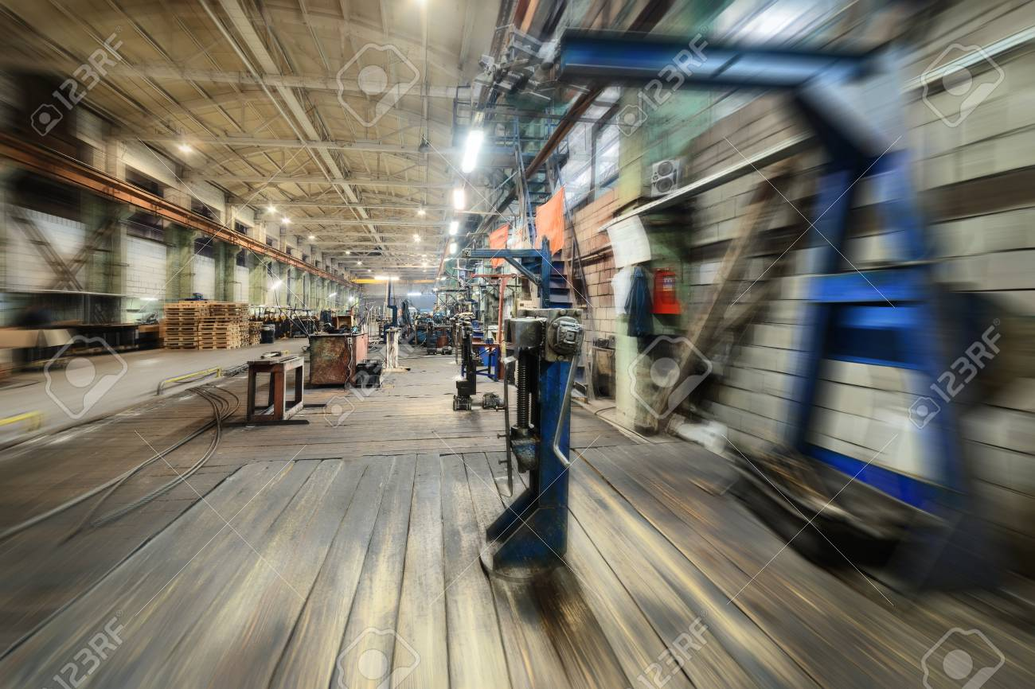
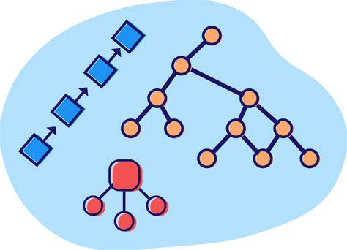
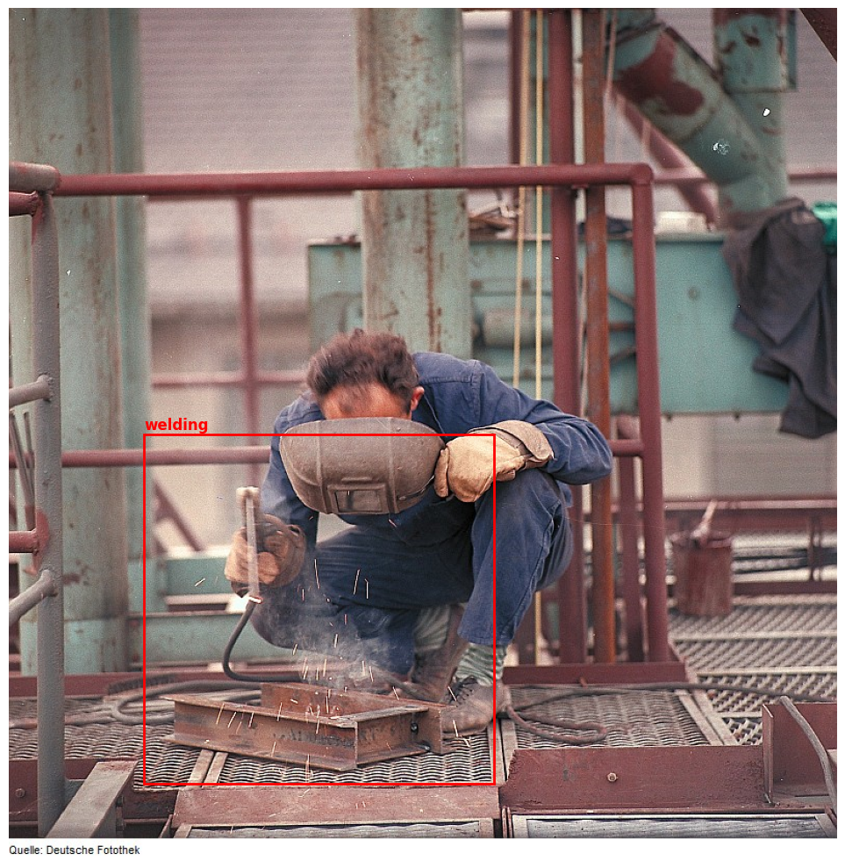
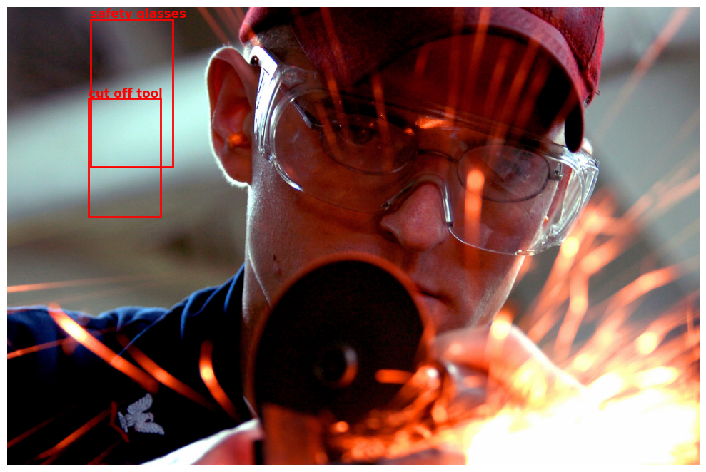
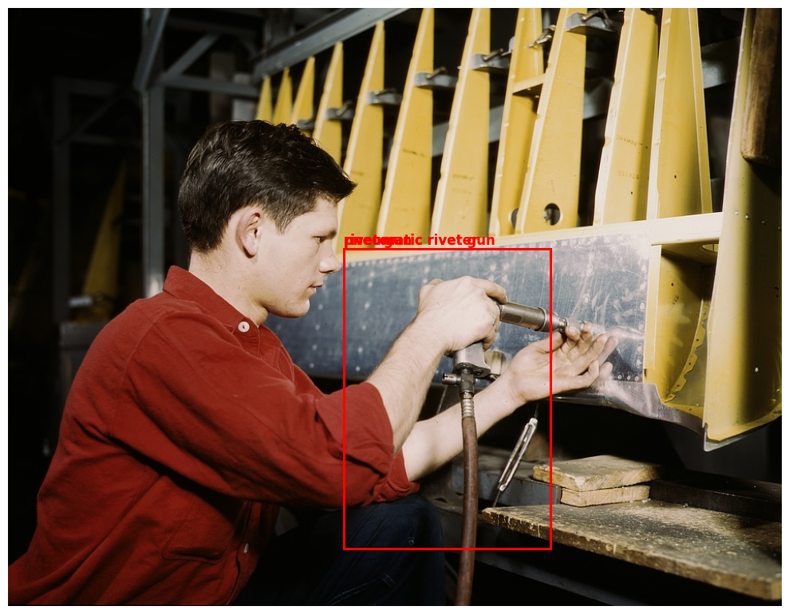
Introduction
https://www.google.com/url?sa=i&url=https%3A%2F%2Fwww.123rf.com%2Fphoto_93863696_factory-shop-abstract-industrial-background-motion-blur-effect.html&psig=AOvVaw12xcVBNSzqfc93HKBmiTLq&ust=1724511228989000&source=images&cd=vfe&opi=89978449&ved=0CBcQjhxqFwoTCKic5Zavi4gDFQAAAAAdAAAAABAE
Low resolution, blurriness, poor lighting conditions, noise or artifacts
Lack of data structure, class imbalance
Overlapping, inaccurate labels
Bounding box placement
Major difference in input consistency impacts AI driven machine vision systems
With over 20,000 images containing redundant, misspelled, or conflicting labels, learning patterns becomes difficult
Structuring, organizing, and sanitizing labels into meaningful classes unlocks the potential of the dataset

Slide 7
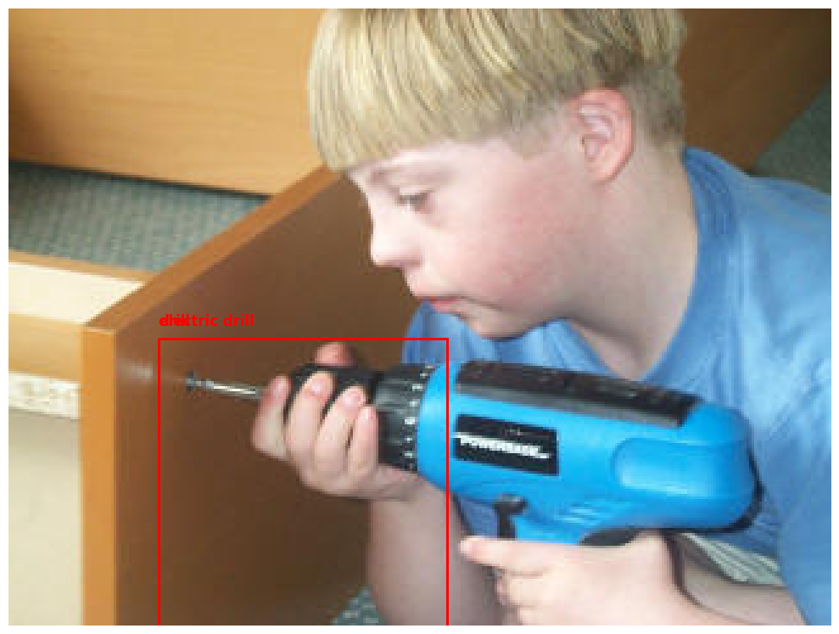
Data Organization Challenge
Data Exploration
Data Cleaning
Unknown Labels (1000+)
"dorfmuseum" "industriedenkmal"
"wehrhahn"
"kailyard“
Data Sanitizing
Data Organization
Data Clustering
Over generalization reduces model robustness and may lead to sparse data points
A hierarchical labeling structure is needed to ensure classes are mutually exclusive to reduce ambiguity and minimize conflicting labels
Presence of typos, synonyms, and case sensitivity could contribute to the ambiguity and noise in the dataset.
Taxonomy Approach
Dropping out bad data is not an option as it would result in remaining 1000-2000 points

Slide 8
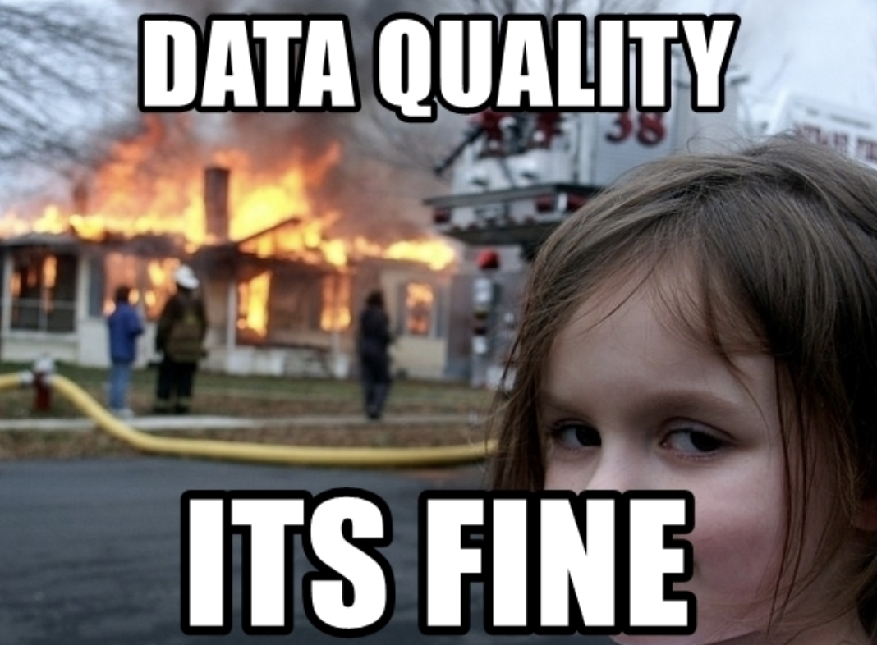
Classification Model Challenge
Overly complex models risk overfitting, while simpler ones may fail to capture class distinctions.
Define meaningful classes
With a limited dataset, overfitting is a major concern.
Resnet152 vs Resnet 50 vs Resnet18
Notes:
There is no one size fits all approach. Overly complex models risk overfitting, while simpler ones may fail to capture class distinctions. There must be a careful selection of models that strike the balance in flexibility and specificity.
The classes must be statistically significant and relevant to real-world applications while avoiding similar classes and maintaining meaningful distinctions.
With a limited dataset, overfitting is a major concern.
Resnet152 vs Resnet18

Slide 9
Methodology

Slide 10
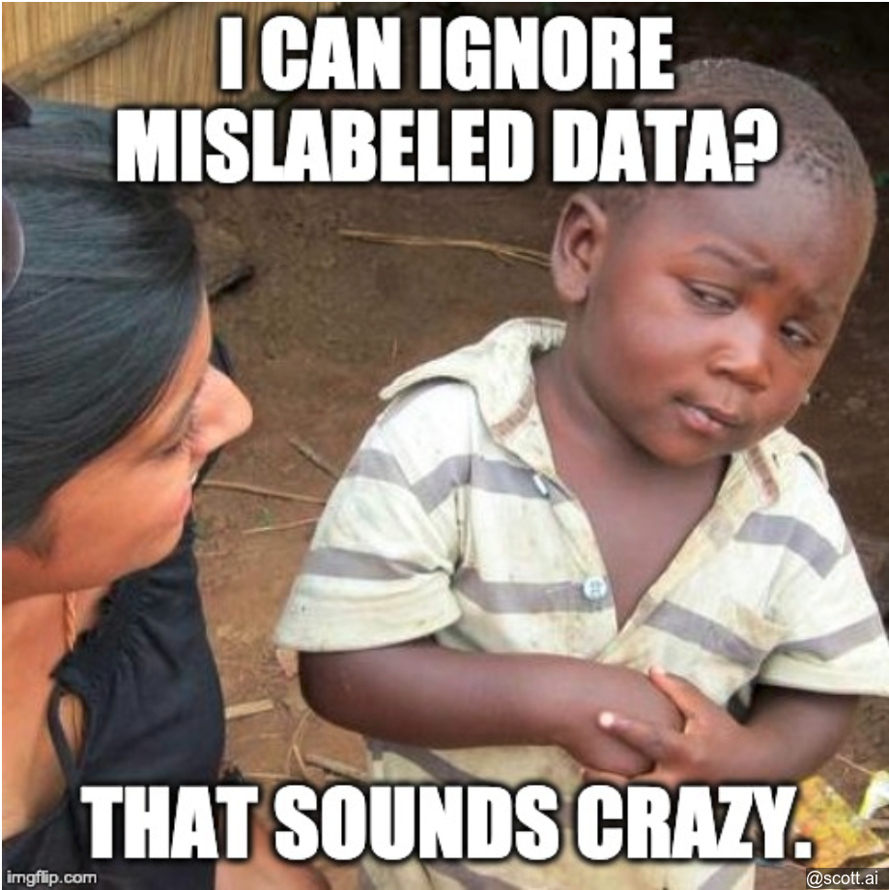
Data Sanitization and Preprocessing
Clustering and Taxonomy:
Manufacturing-specific taxonomy can be categorized into labels like “tools”, “processes”, “material”, etc.
Agglomerative clustering minimizes the variance by merging similar clusters
Fuzzy matching was used for outliers, defaulted to “equipment” as a fallback
Inconsistencies:
Image Preprocessing:
Adjusted images for consistent resolution and aspect ratio
Balanced class distribution through targeted augmentations
Typos, case sensitivity, and synonymous labels

Slide 11
Classification, Training, Validation Strategy
Model Choice
ResNet152 was selected for its state-of-the-art performance in vision tasks
Concerned with overfitting shifted to simpler models
The effectiveness relied on meaningful distinctions
Augmentation and Cross-Validation
Class imbalance was addressed with augmentation strategies and cross validation
Hyperparameters were tuned literarily with continuous evaluation
Notes:
Model Choice: ResNet152 was selected for its state-of-the-art performance in challenging tasks. Concerns of overfitting due to a small dataset shifted focus to simpler models.Class Distinctions: The effectiveness relied on meaningful class distinctions.Augmentation and Cross-Validation: Class imbalance was addressed using augmentation strategies and cross-validation. Hyperparameters were tuned iteratively with continuous evaluation to ensure generalization across classes without sacrificing accuracy.

Slide 12
Implementation

Slide 13

Model Implementation
PyTorch framework
System equipped with two RTX 3090 GPUs (24 GiB VRAM) and 128 GB of RAM

Slide 14
Results & Evaluation

Slide 15
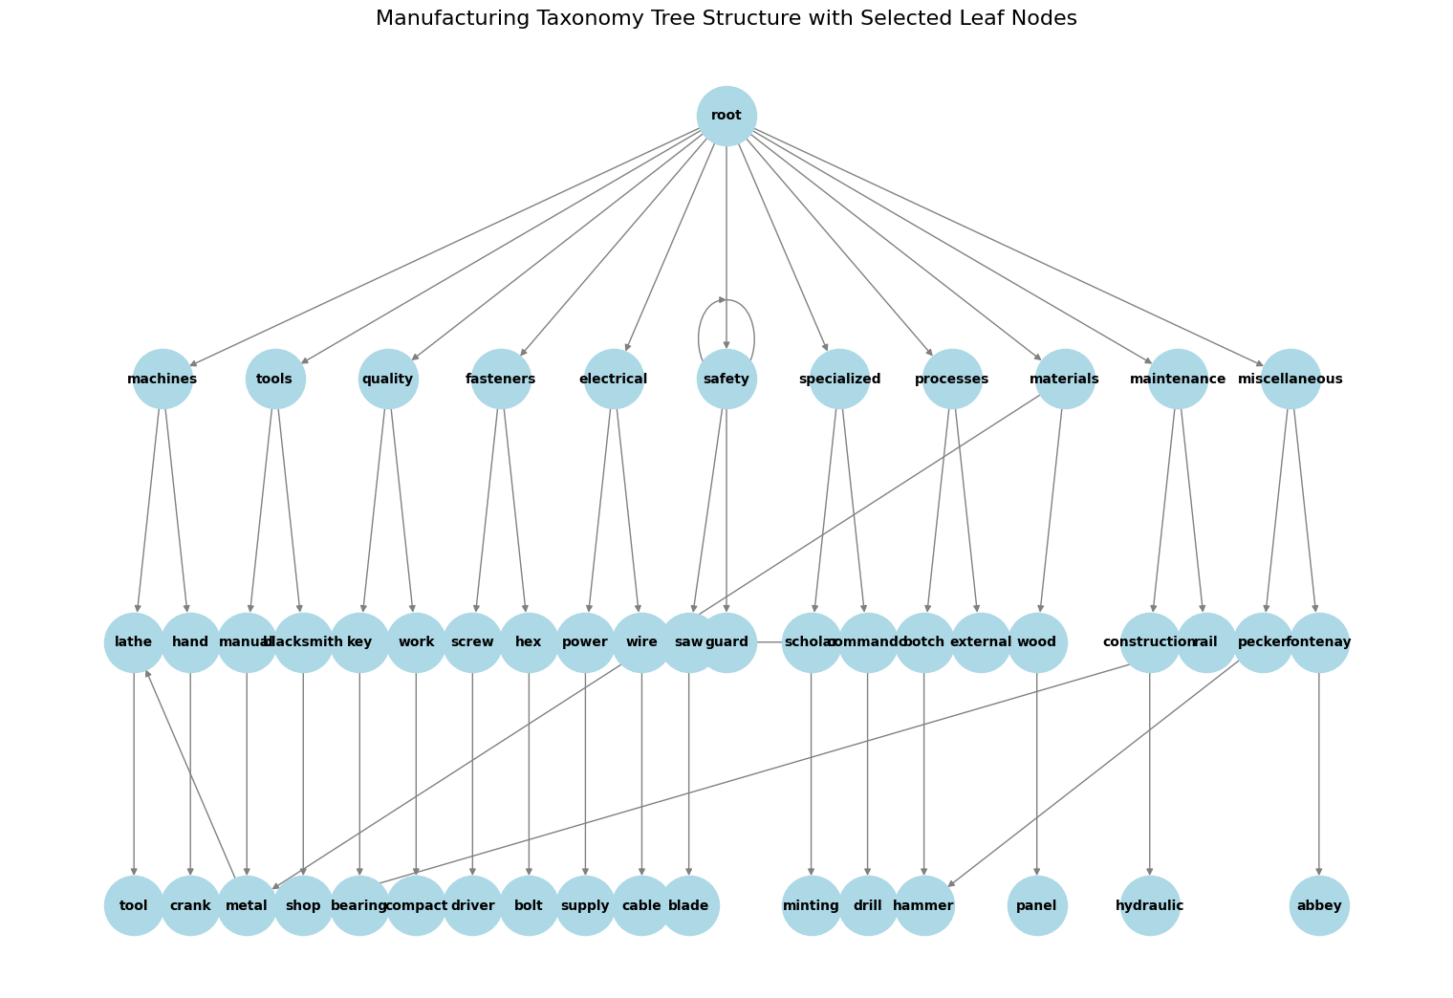
Data Organization Results Cont.

Slide 16
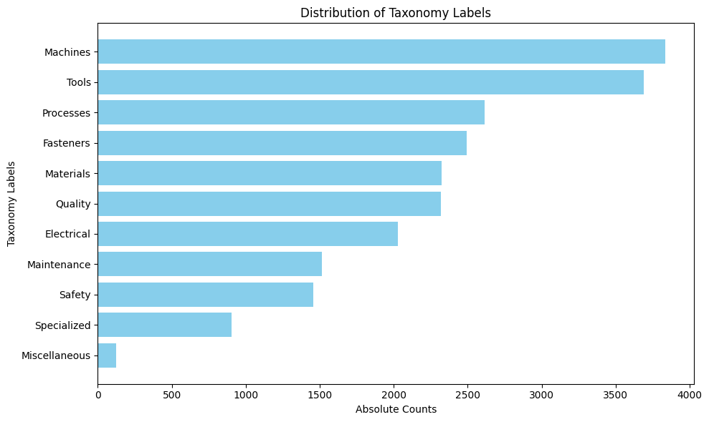
Data Organization Results
Reduced from ~23,000 labels to 11 organized categories
Miscellaneous words mostly included: "dorfmuseum", "industriedenkmal", "wehrhahn", "kailyard“

Slide 17
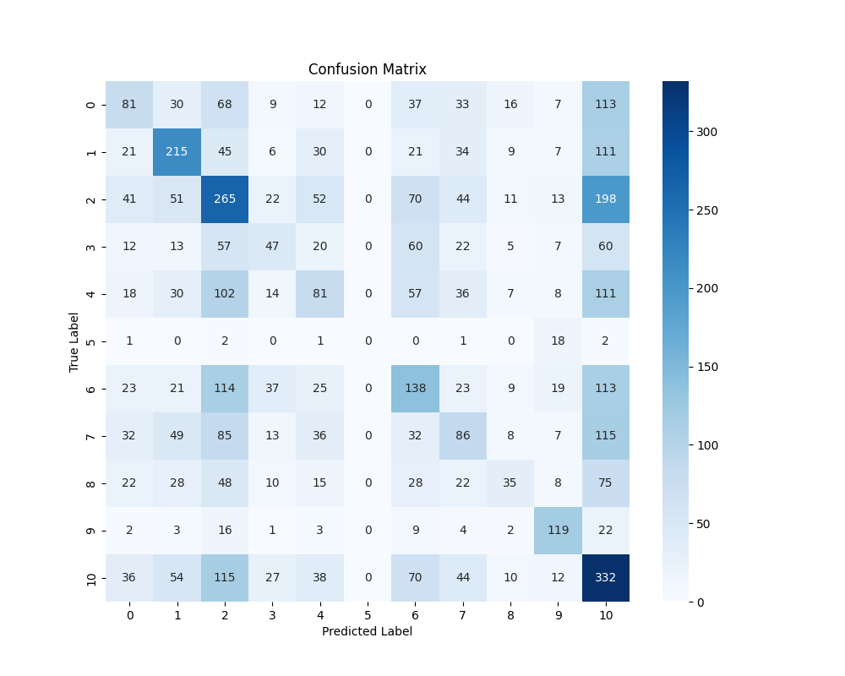
Classification Model Results
The model achieved best performance with a learning rate of 0.01 and a batch size of 128 – determined through cross validation
Resnet18: 40%
Resnet50: 42%
Resnet152: 45%

Slide 18
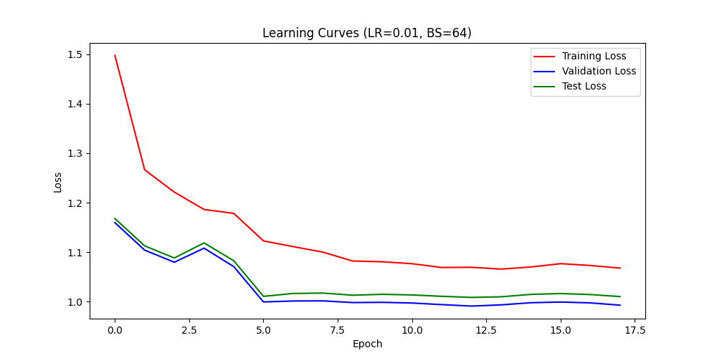
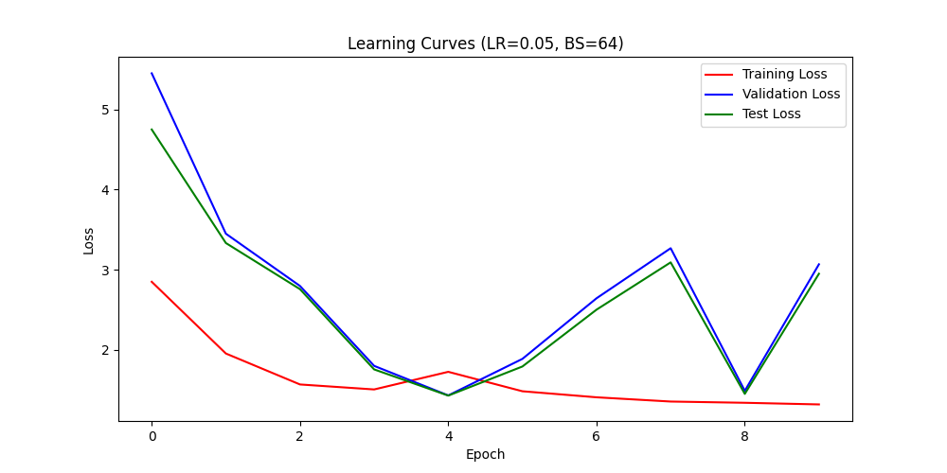
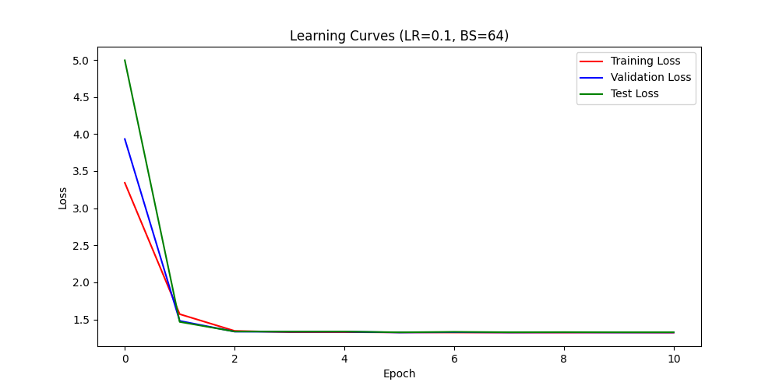
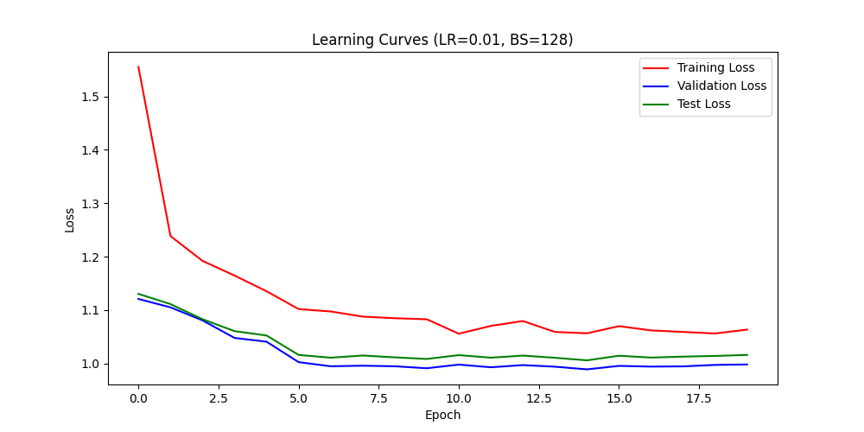
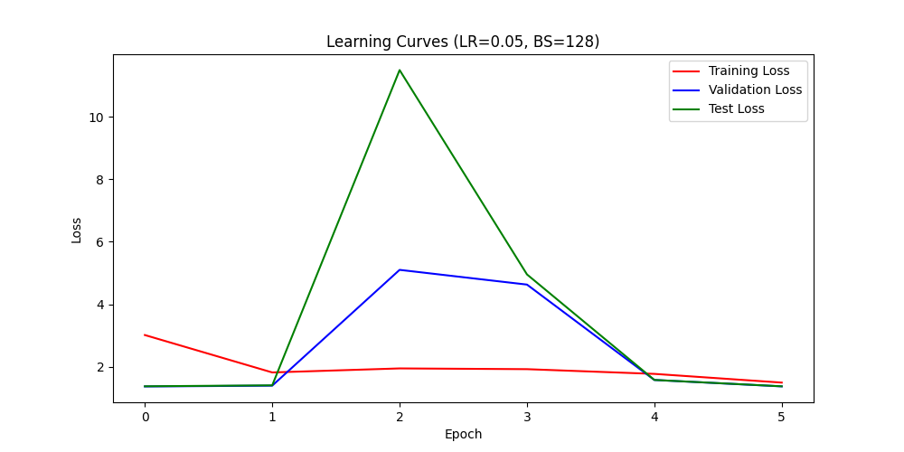
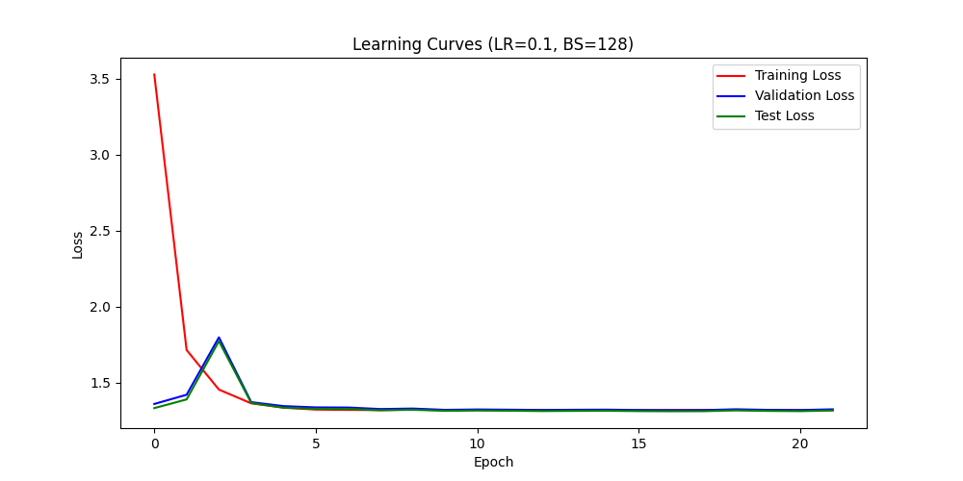
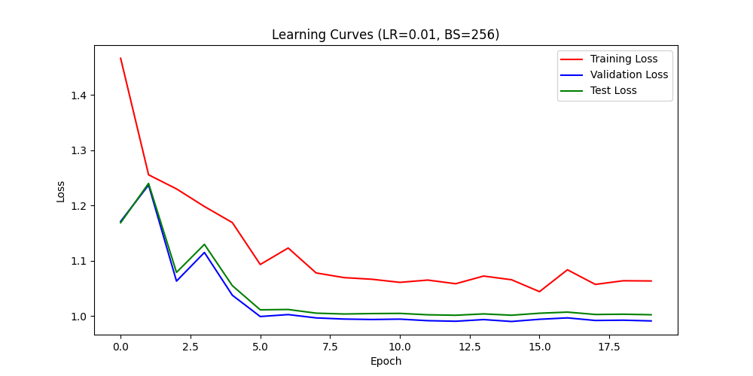
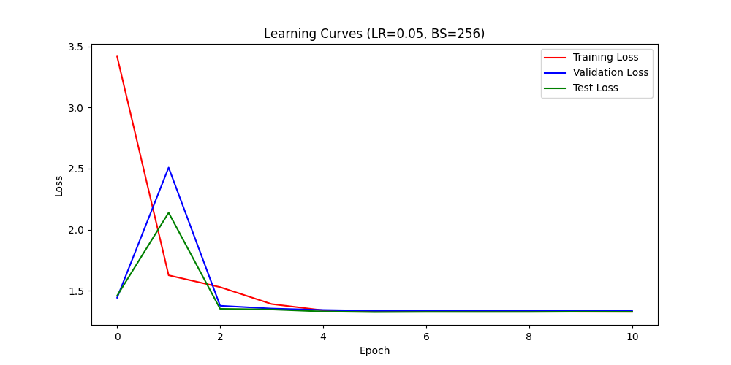
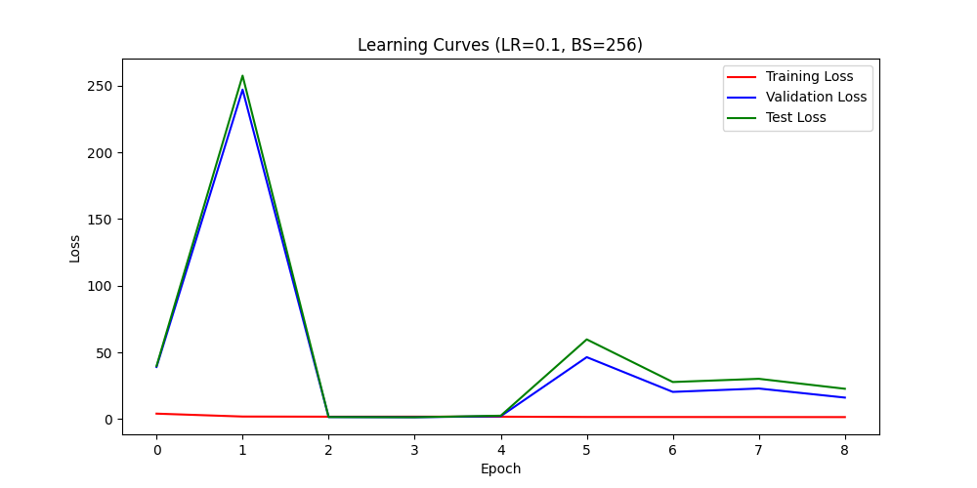

Slide 19
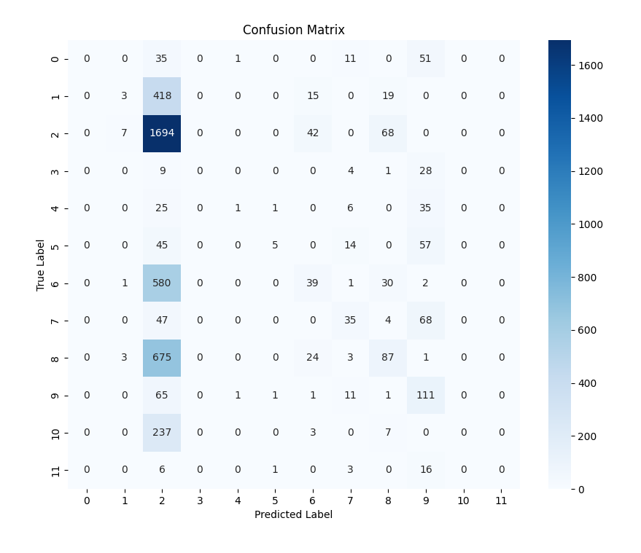
Comparative Analysis

Slide 20
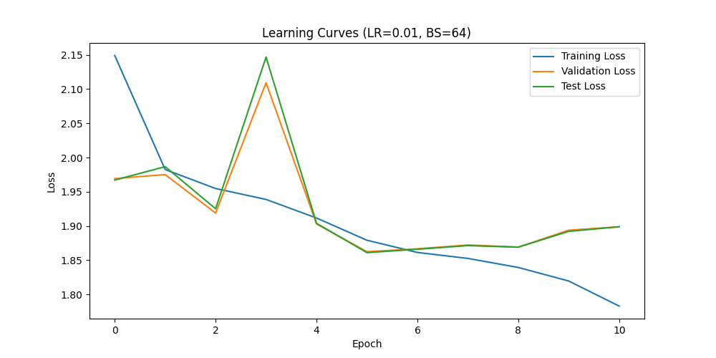
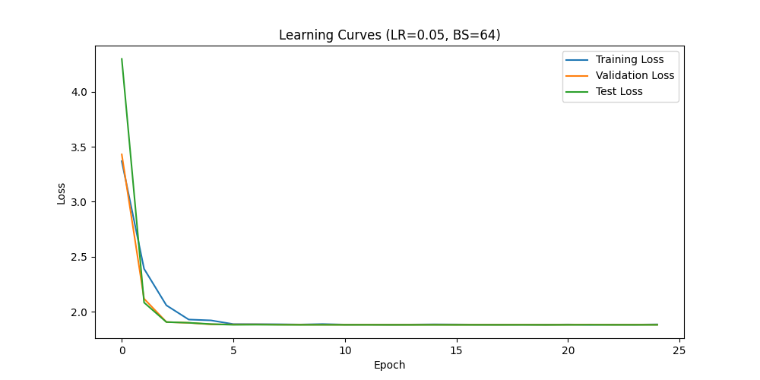
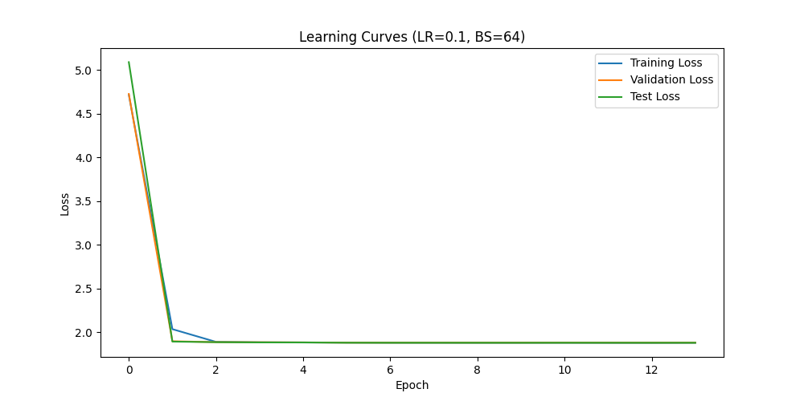
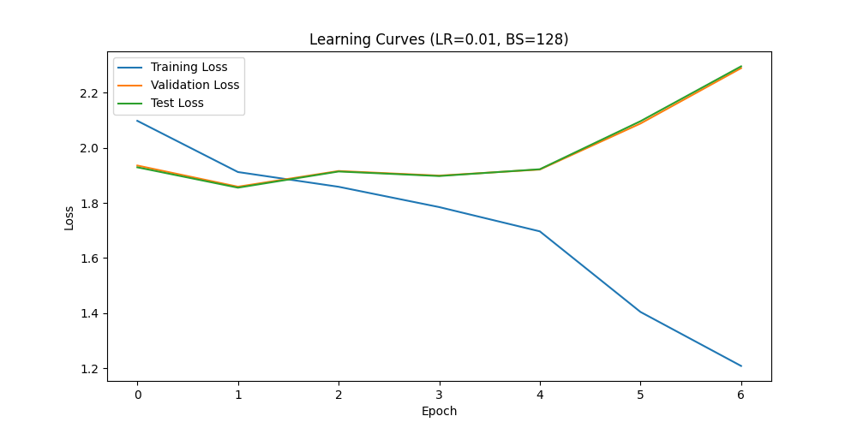
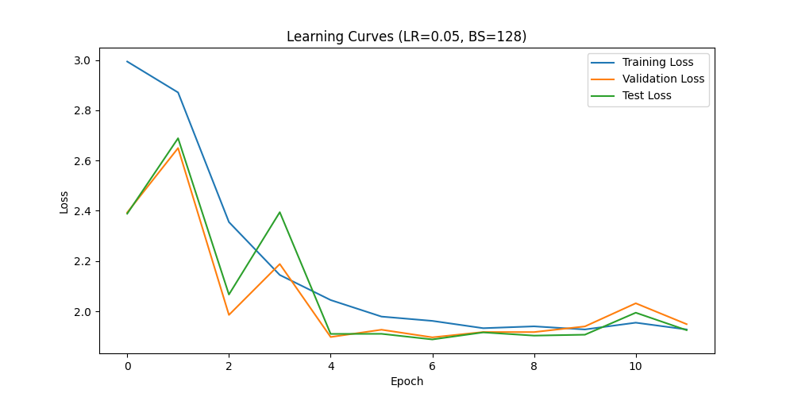
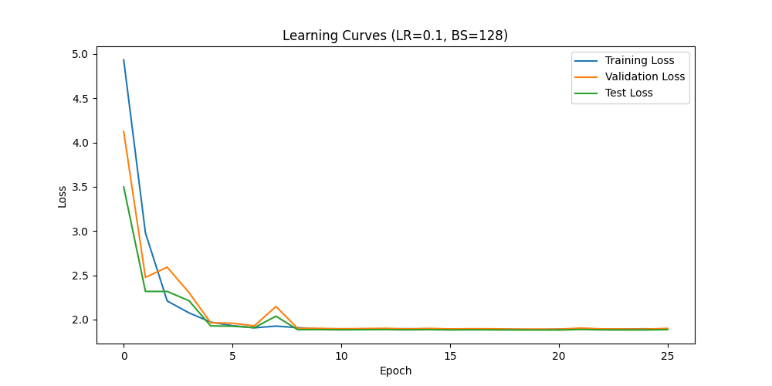
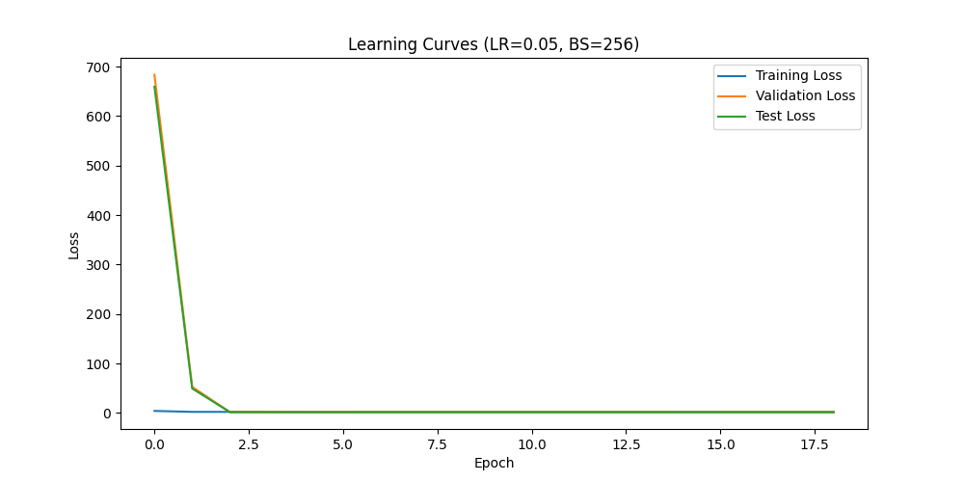
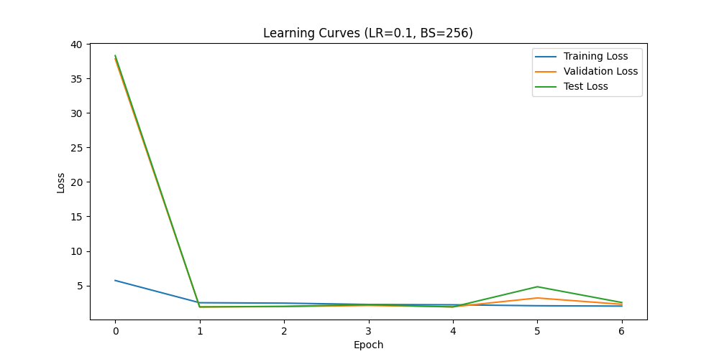
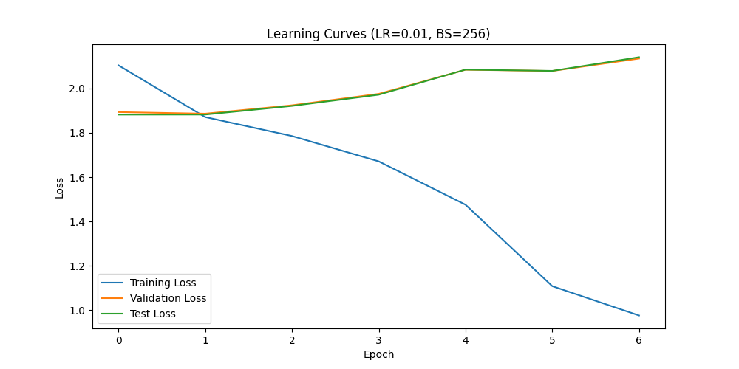

Slide 21
Discussion

Slide 22
Methodology Explored
Hierarchical Clustering
Community Clustering
Sampling Techniques
Resulting clusters too granular/broad
Struggled with high dimensionality and ambiguity of the labels, clusters were either irrelevant or disconnected
Oversampling
Under sampling
Notes:
Hierarchical Clustering
Resulting clusters too granular/broad
Community Clustering
Struggled with high dimensionality and ambiguity of the labels, clusters were either irrelevant or disconnected
Radom Sample Down sampling
Down sampling introduced noise and discarded important data

Slide 23
Hierarchical Clustering Top Approach
Root
0
2
3
1
4
5
11
10
7
6
12
16
15
17
13
14
8
9

Slide 24
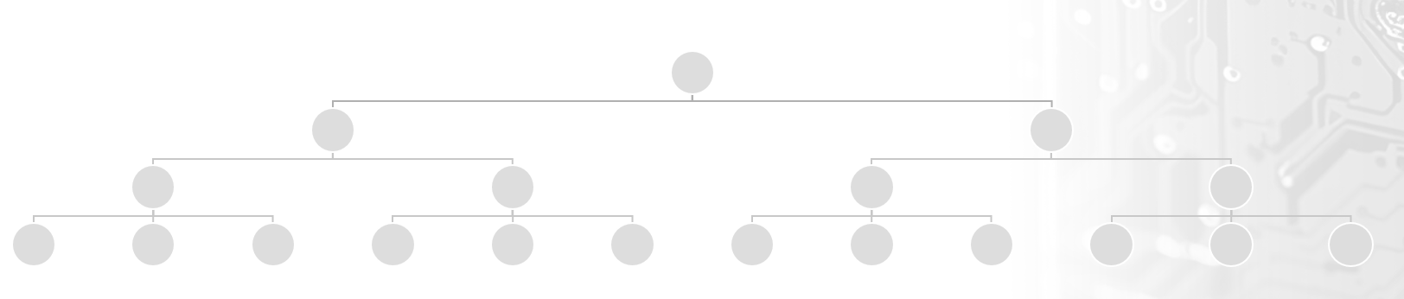
Hierarchical Clustering Bottom Approach

Slide 25
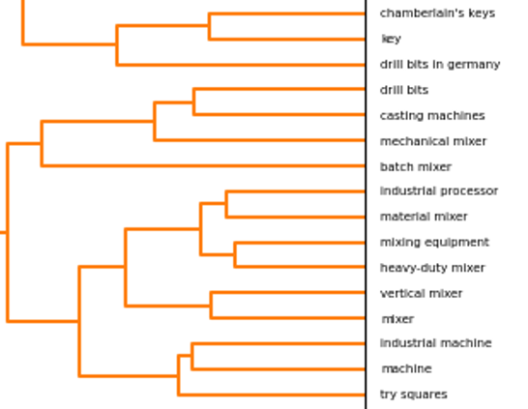
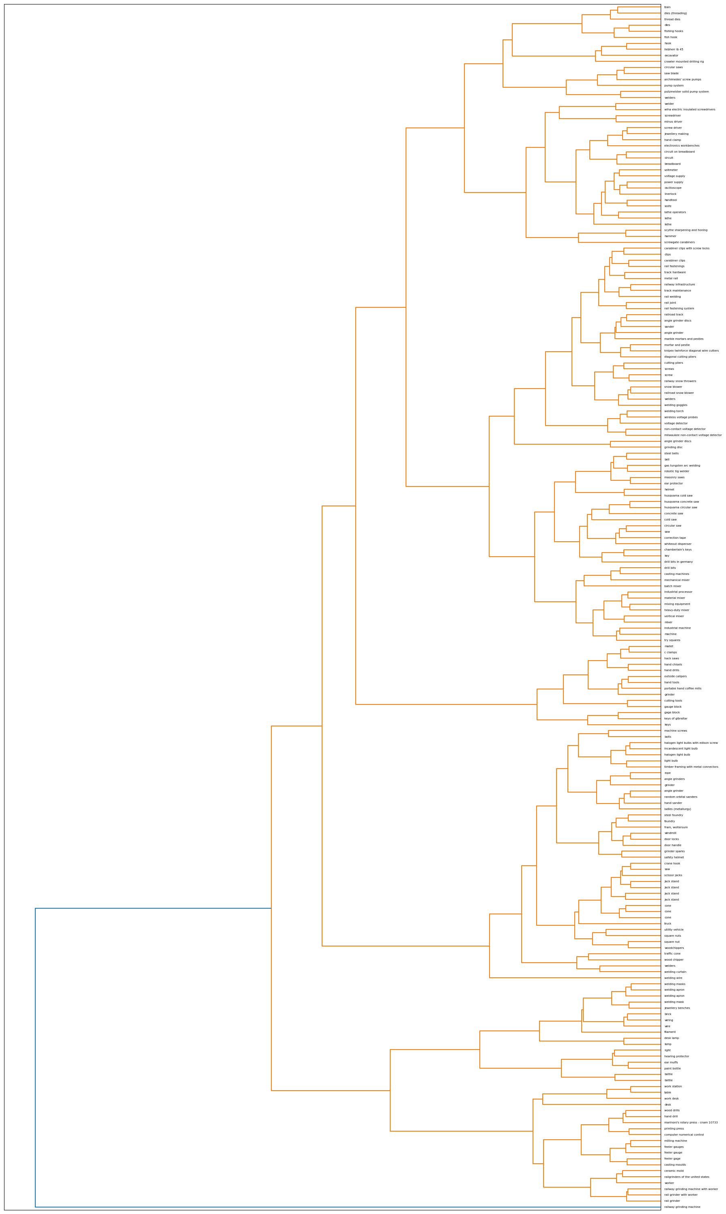
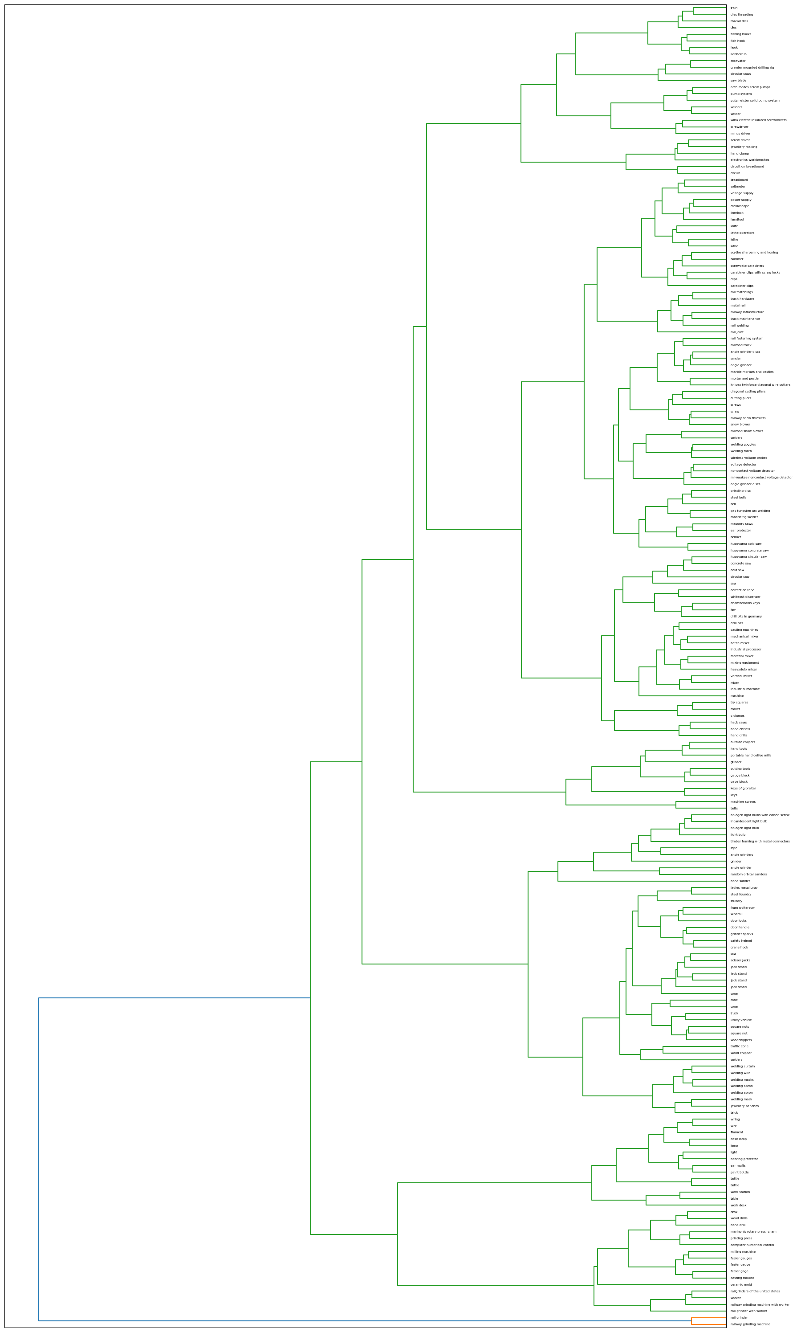
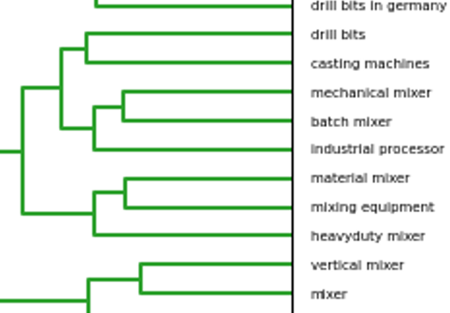
Hierarchical Clustering

Slide 26
Methods Explored
Hierarchical Clustering
Community Clustering
Radom Sample Down sampling
Resulting clusters too granular/broad
Struggled with high dimensionality and ambiguity of the labels, clusters were either irrelevant or disconnected
Down sampling introduced noise and discarded important data
Notes:
Hierarchical Clustering
Resulting clusters too granular/broad
Community Clustering
Struggled with high dimensionality and ambiguity of the labels, clusters were either irrelevant or disconnected
Radom Sample Down sampling
Down sampling introduced noise and discarded important data

Slide 27
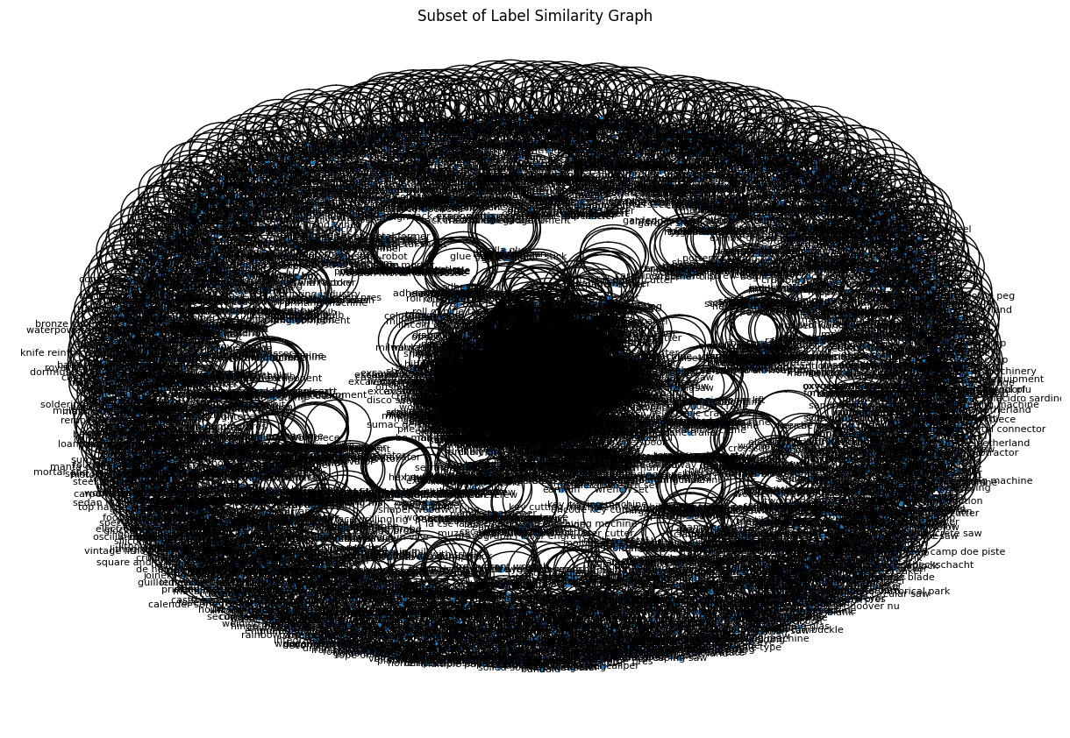
Community Clustering
Community 1: ['worker', 'construction work', 'construction', 'factory worker', 'construction worker']
Community 5: ['worker with milling machine', 'milling bit', 'milling machine shop', 'electrical machining tool', 'milling machine rotary table', 'taxi milling machine’, etc.]
Community 1303: ['wall hook', 'towheaded industrial hook', 'coat hook', 'fishing hook', 'hand hook', 'towheaded hook', 'hook hand tool', 'boat hook', 'fish hook with bait', 'industrial hook', 'fish hook’]
Community 1270: ['wire bending hand tool', 'sheet metal bending machine', 'plate bending machine', 'schmalz speedway wire bending machine', 'bending machine', 'wire bending machine’]

Slide 28
Obstacles Faced
Data Organization:
Classification Model:
Label inconsistency
Dealing with inconsistent labels, typos and redundant terms (e.g., “industry monument” vs “IndustrieDenkmal”)
Resolved with fuzzy matching, hierarchical clustering, and a manual curation to consolidate synonymous terms into meaningful categories
Bounding box inconsistency
Class imbalance
Severe class imbalance required creative solutions without introducing too much noise
Integration of custom dataset class
Weighted cross-entropy loss and custom focal loss function were implemented to counter class imbalance
Mixed sampling
Implemented step scheduler and early stopping mechanism to prevent overfitting

Slide 29
Conclusion

Slide 30
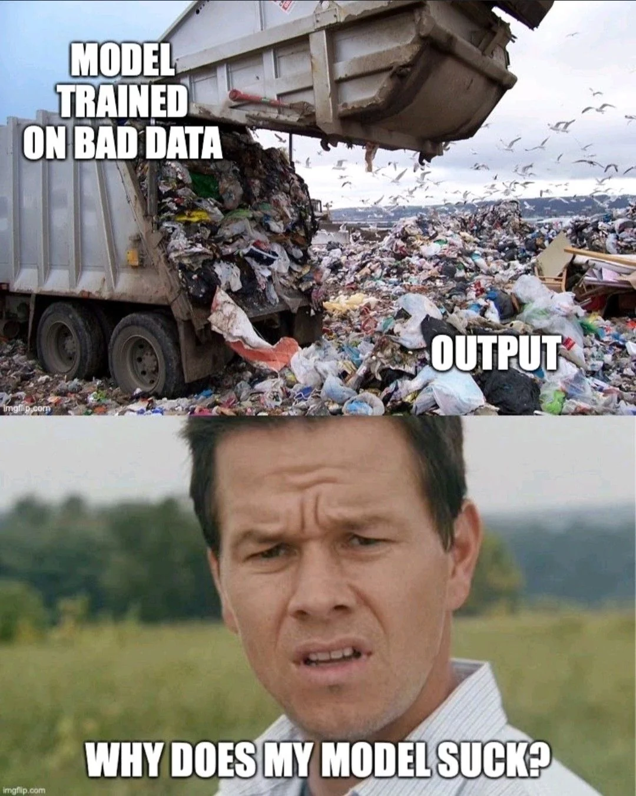
Conclusion
The project resulted in a refined and structured hierarchical dataset with 10 classes
Combining targeted data cleaning with tailored model design is an approach for handling imbalanced and noisy datasets
Further exploration could include integrating more advanced augmentation techniques or experimenting alternative models.

Slide 31
Code and Reproducibility
The entire codebase is uploaded onto this GitHub Repo.

Slide 32
Acknowledgements
We would like to thank Dr. Vinh Nguyen and Dr. Evan Lucas for the support and dedication. We would also like to thank the Center of AI at Michigan Technological University for this opportunity.

Slide 33
Works Cited
[1] L. Nagy, T. Ruppert, and János Abonyi, “Ontology-Based Analysis of Manufacturing Processes: Lessons Learned from the Case Study of Wire Harness Production,” Complexity, vol. 2021, pp. 1–21, Nov. 2021, doi: https://doi.org/10.1155/2021/8603515.
[2] F. Murtagh and P. Legendre, “Ward’s Hierarchical Agglomerative Clustering Method: Which Algorithms Implement Ward’s Criterion?,” Journal of Classification, vol. 31, no. 3, pp. 274–295, Oct. 2014, doi: https://doi.org/10.1007/s00357-014-9161-z.
[3] “Hierarchical clustering: structured vs unstructured ward,” scikit-learn, 2024. https://scikit-learn.org/stable/auto_examples/cluster/plot_ward_structured_vs_unstructured.html (accessed Aug. 23, 2024).
[4] “Google Colab,” Google.com, 2019. https://colab.research.google.com/github/dipanjanS/nlp_workshop_odsc19/blob/master/Module05%20-%20NLP%20Applications/Project02%20-%20Text_Clustering.ipynb#scrollTo=praegyPtQ6Xk (accessed Aug. 23, 2024).
[5] S. Targ, D. Almeida, and K. Lyman, “Resnet in Resnet: Generalizing Residual Architectures,” arXiv:1603.08029 [cs, stat], Mar. 2016, Available: https://arxiv.org/abs/1603.08029
[6] F. He, T. Liu, and D. Tao, “Why ResNet Works? Residuals Generalize,” IEEE Transactions on Neural Networks and Learning Systems, pp. 1–14, 2020, doi: https://doi.org/10.1109/tnnls.2020.2966319.
[7] C. Szegedy, S. Ioffe, V. Vanhoucke, and A. Alemi, “Inception-v4, Inception-ResNet and the Impact of Residual Connections on Learning,” Proceedings of the AAAI Conference on Artificial Intelligence, vol. 31, no. 1, Feb. 2017, Available: https://ojs.aaai.org/index.php/AAAI/article/view/11231

